Slide 1
hello!
Before we start
Everyone should have R and R Studio installed.
Install R
Mac: https://cran.rstudio.com/bin/macosx/R-3.5.2.pkg Windows: https://cran.rstudio.com/bin/windows/base/R-3.5.2-win.exe
Install R Studio
Mac: https://download1.rstudio.org/RStudio-1.1.463.dmg Windows: https://download1.rstudio.org/RStudio-1.1.463.exe

Slide 2
welcome
An introduction to data science in R
Will Mackey and ESSA Monash
Monday 18th March, 2019

Slide 3
Workshop structure
welcome
Getting started in R
Scripts and coding
Reading data
Exploring with visuals
Transforming our data
Making maps
[Additional resources]

Slide 4
welcome
Who am I?
I am Will (hello!), an Associate at the Grattan Institute.
I like to make R packages/functions in my spare time. I also like to write documentation and guides that make using R easier.
At Grattan, we use R for our data analysis and visualisations. (We’re also looking into producing our entire reports in R).
We use data to answer questions.

Slide 5
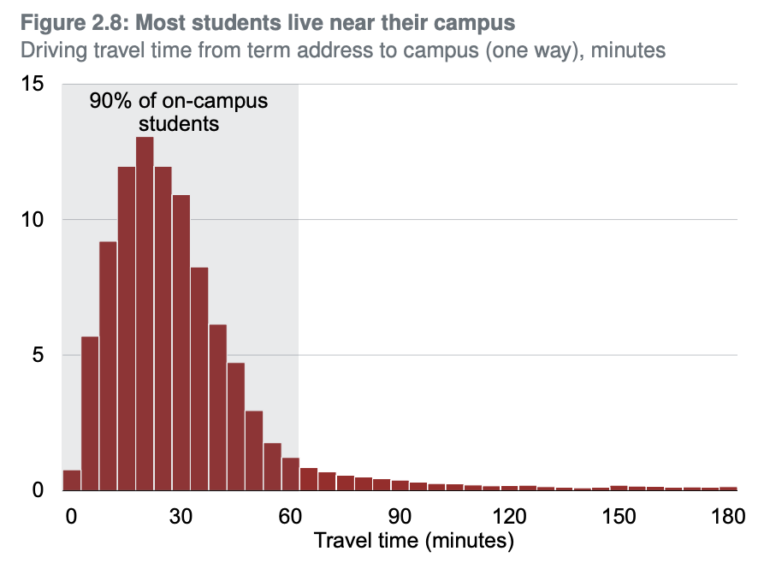
welcome
How Grattan uses R
Does living far away from your university increase your chance of dropping out?
Wrangle a large dataset
16m anonymised observations with 120 variables
Join with other datasets
join with 171m and 3.5m observation datasets
Generate new data
driving time from Google Maps API
Chart
plot a distribution of travel distance
Analyse
Logistic regression to understand the relationship between long travel times to university and degree completion.
From Cherastidtham, I., Norton, A., and Mackey, W. (2018). University attrition: what helps and what hinders university completion?. Grattan Institute

Slide 6
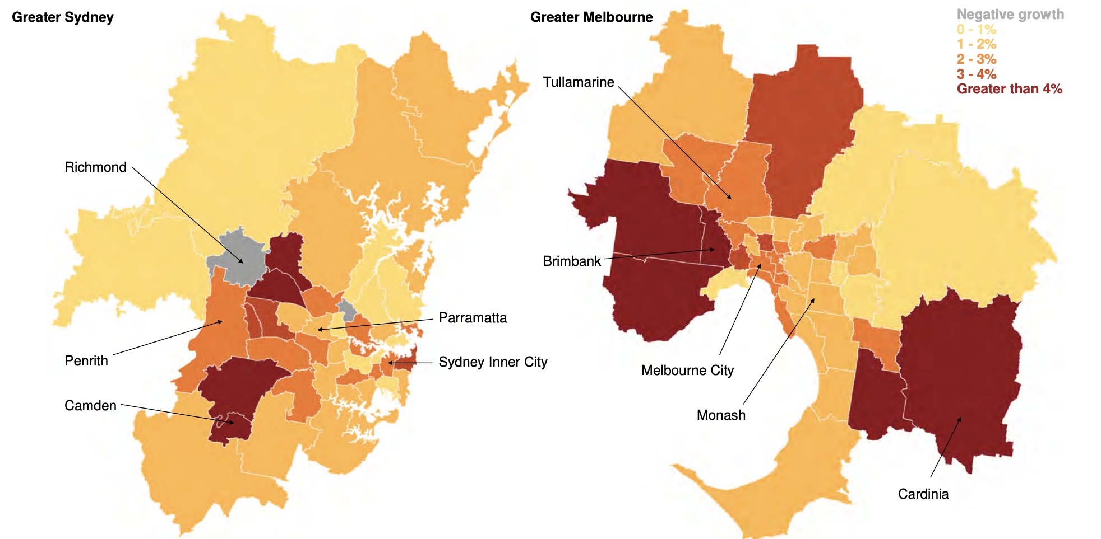
welcome
How Grattan uses R
How has job growth been distributed around the major cities?
Get jobs data by area from the 2011 and 2016 Census
Calculate growth in each area.
Join with geometric data from the ABS.
Plot maps of job growth.
Figure 2.5: In Sydney and Melbourne, jobs have grown in the CBD and central areas, but they’ve grown fastest in the outer areas Average annual employment growth, 2011 to 2016, SA3
From Terrill, M., Batrouney, H., Ha, James, and Hourani, D. (2018). Remarkably adaptive: Australian cities in a time of growth. Grattan Institute.

Slide 7
welcome
Why are we all here?
We are here to learn more about data science and R.
We are doing this because we want extract insight out of data. We want to be able to learn something from the information we have.
Data it fun! But it can be hard to make sense of.

Slide 8
welcome
What we are doing with data science
explore and understand
visualise
communicate
read
data
transform
analyse
Model adapted from Wickham (2019) R for Data Science

Slide 9
The same method
Made by Timo Grossenbacher in R using ggplot.
It’s really nice.
The code used recreation can be found here: https://timogrossenbacher.ch/2016/12/beautiful-thematic-maps-with-ggplot2-only/

Slide 10
welcome
What is R?
R is a free, open-source statistical package.
It was created in New Zealand in the 1990s.
With more people using it, and more user-written functions and guides, it has become much easier to use.

Slide 11
preamble

Slide 12
preamble
A script-based language
R is a script-based program.
You write a list of instructions and R will follow it.
This is wonderfully handy:
everything you have told it to do, it will do;
you have recorded everything you have told it to do.

Slide 13
preamble
‘Coding’
Coding feels a bit intimidating. But it’s just a list of instructions.
If you have ever used Excel, you are a coder:
You have used functions to create output. You have written code.
And we can greatly enhance the things we can do by using R.

Slide 14
preamble
‘Coding’
We often perform a list of instructions. For example, in Excel you:
Open a file.
Delete column that you don’t need.
Select all of your data and sort from highest to lowest.
Do a calculation using a formula.
Delete all the rows that have missing values.
Save your file.
We can do the same things when we code. We just write down the list explicitly.

Slide 15
preamble
‘Coding’
We can do the same things when we code. We just write down the list explicitly.
This is beneficial:
There is a record of everything you have done.
It will do everything you want every time (you won’t miss a step!)

Slide 16
preamble
Why R
There are many proprietary script-based programs for analysing data: Stata, SAS, Eviews, SPSS, Matlab.
Proprietary programs cost $$$:
If you are not at a university/workplace that has the program, you can’t use it.
Or you will have to pay for a license yourself.

Slide 17
preamble
Why R
Proprietary programs are also centrally controlled.
The select functions are written by the company, and you can only use the set of functions they provide.
R thrives on user-written packages (collections of functions) that are available to everyone, for free. From a recent study:
“In 2015, R added 1,357 packages, counting only CRAN, or approximately 27,642 functions. During 2015 alone, R added more functions than SAS Institute has written in its entire history.”
From r4stats.com/articles/popularity/ (the potential bias is indicated in its domain)

Slide 18
basics

Slide 19
basics
Open R Studio
R
(not this one)
R Studio
(this one!)

Slide 20
basics
Open R Studio
From with R Studio, open a new script:
File -> New File -> R Script

Slide 21
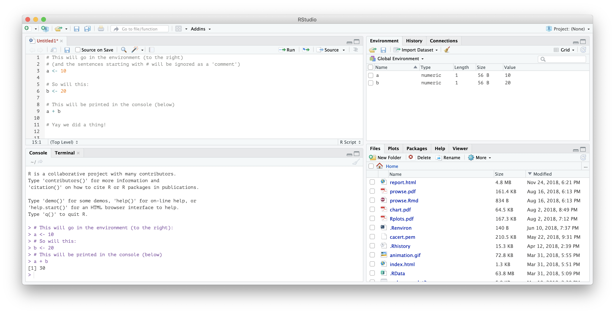
basics
What does R Studio look like?
your
Script
(your list of instructions)
things in your Environment
(the things R knows about)
the
Console
prints the results of your analysis (and presents you with frustrating errors)
The other window for
Files, plots, help
and other things
(a handy window)

Slide 22
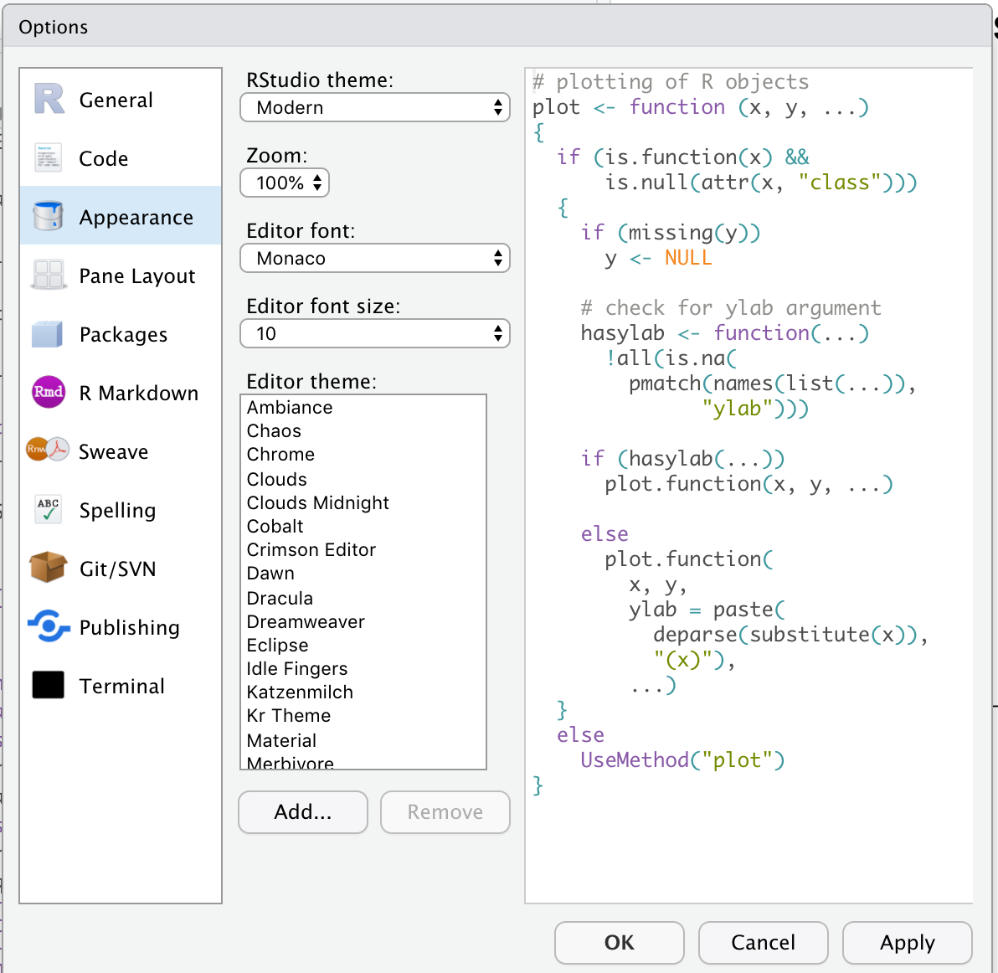
basics
VERY IMPORTANT How to change the look of your R
Go to:
Tools ->
Global options ->
Preferences ->
Appearance
And change the editor theme to something that you like.

Slide 23
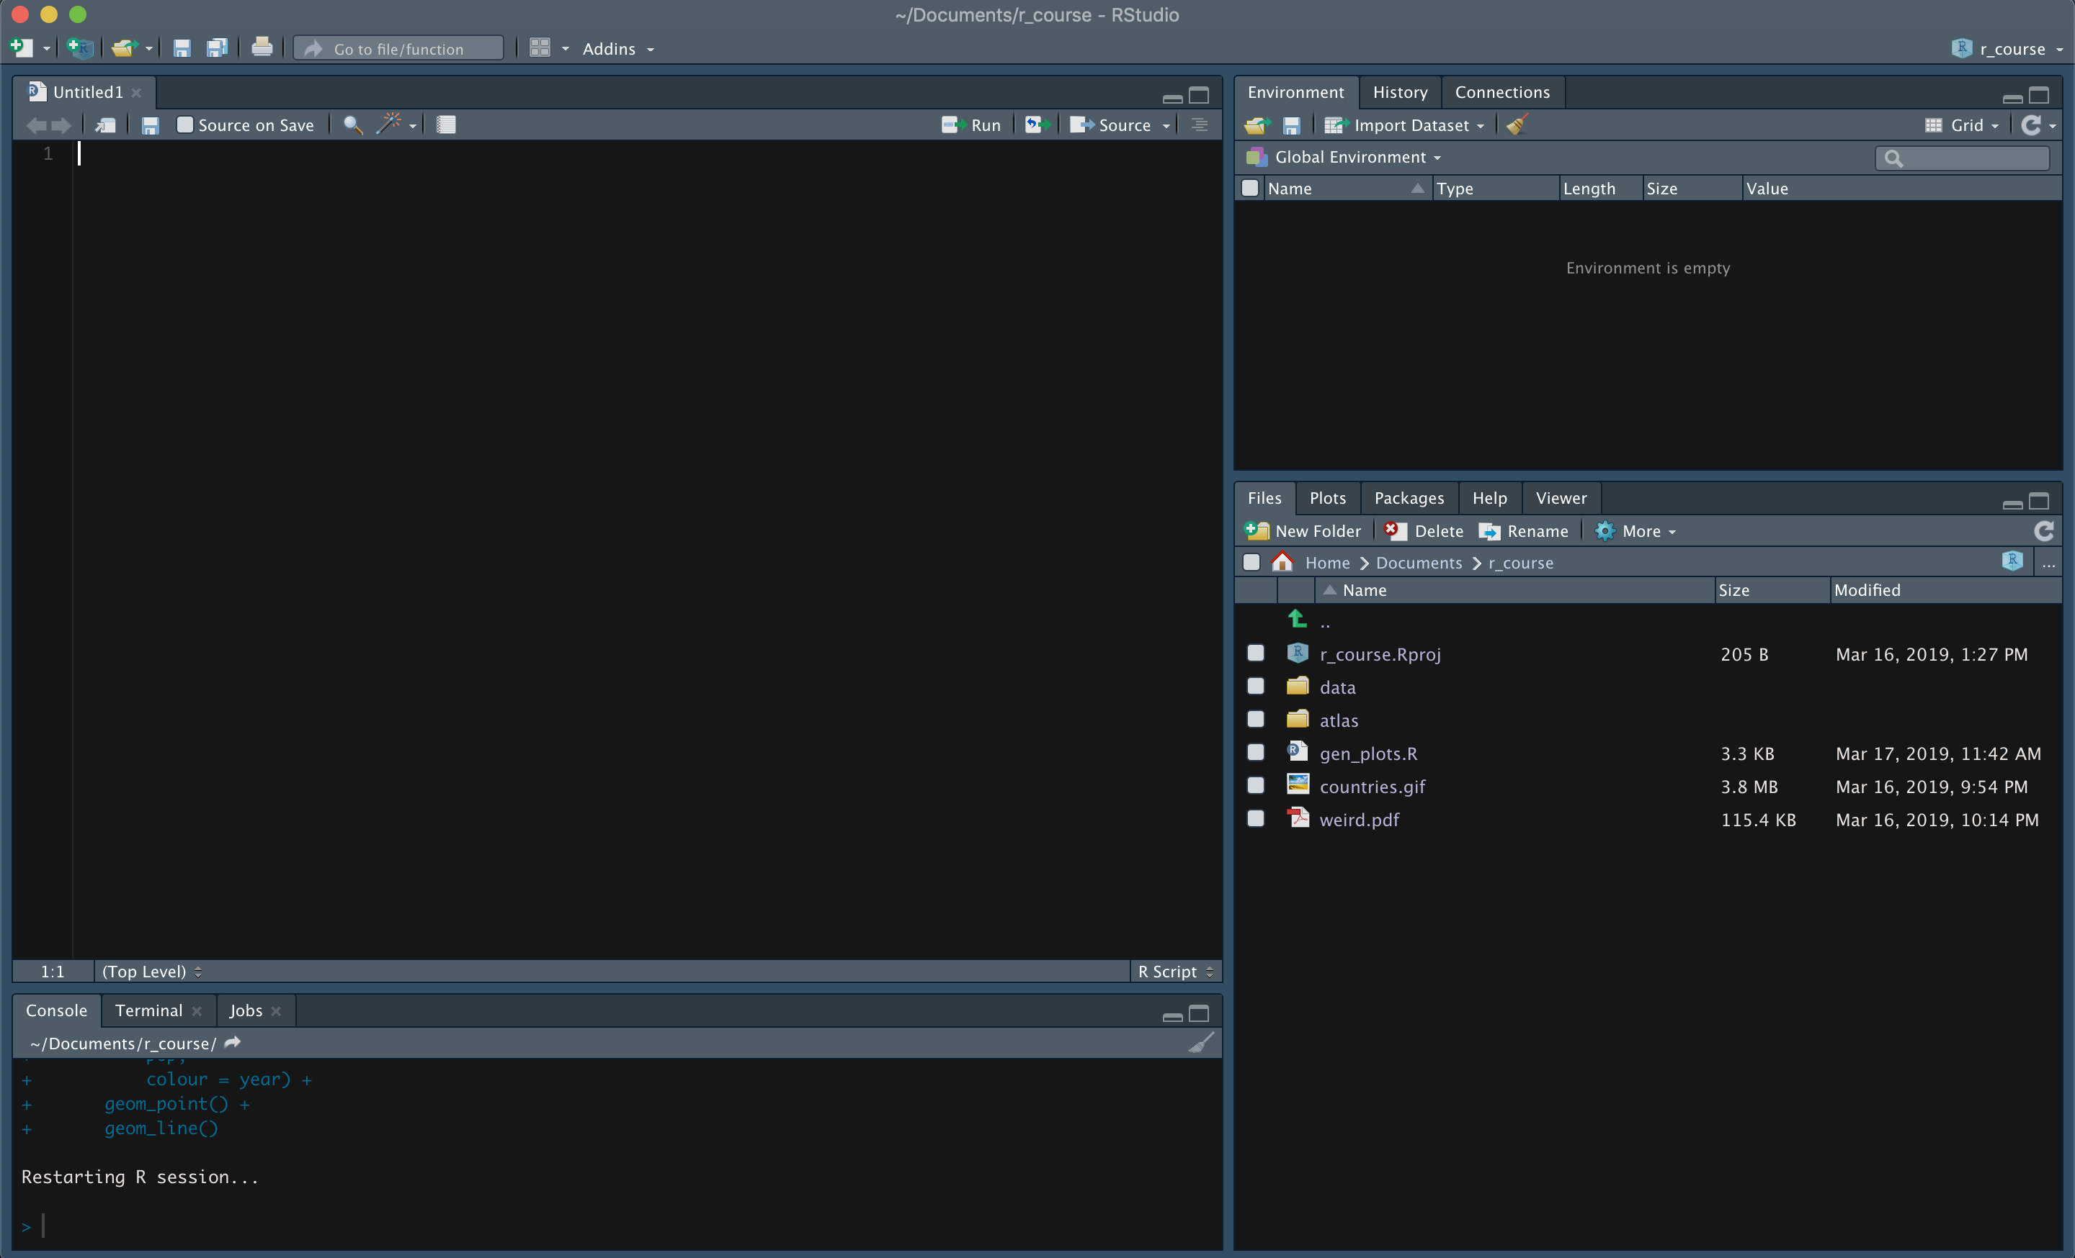
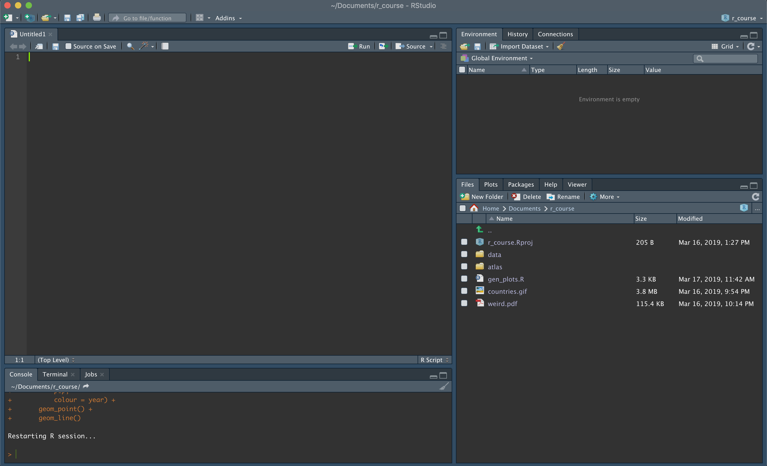
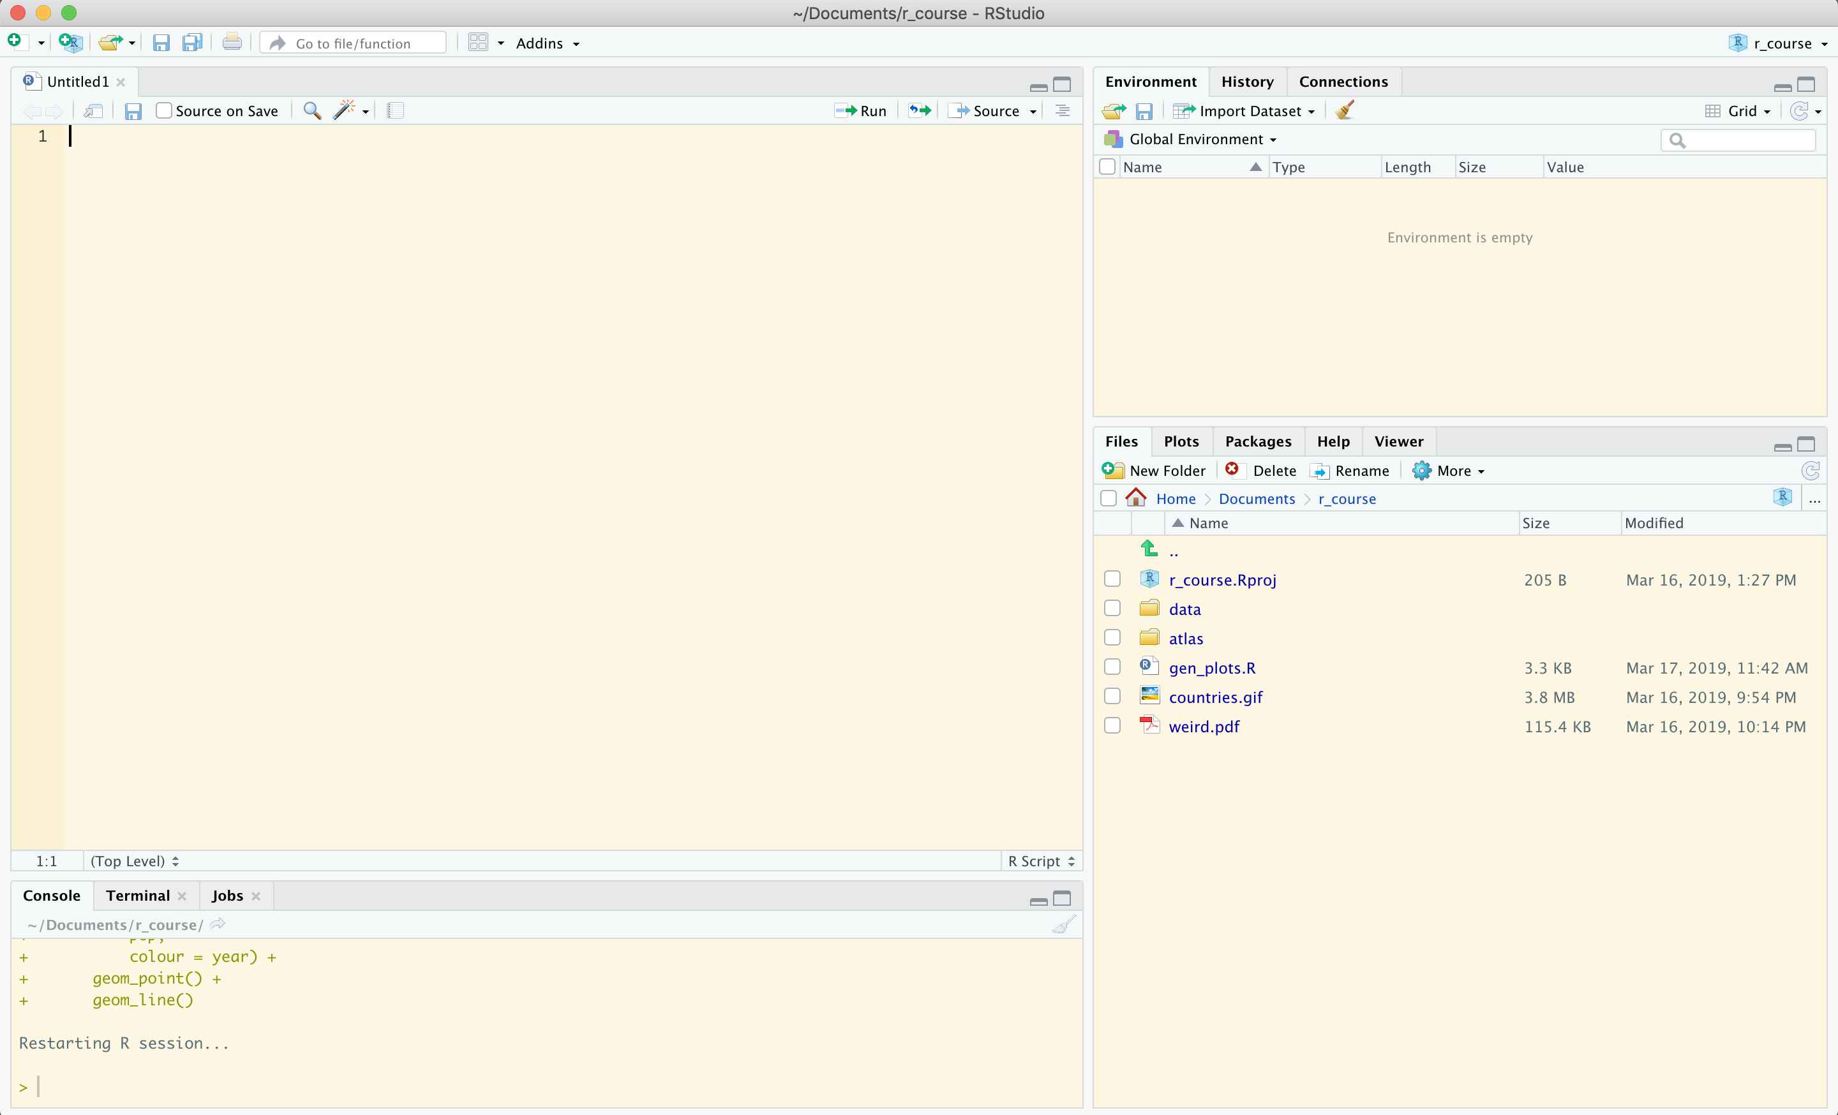
basics
What does your R Studio look like now?
your
Script
(your list of instructions)
things in your Environment
(the things R knows about)
the
Console
prints the results of your analysis (and presents you with frustrating errors)
The other window for
Files, plots, help
and other things
(a handy window)

Slide 24
basics
Writing a script
Our script will be filled with a list of instructions for R to follow.
Let’s do three things first:
Write a comment starting with # (something R will ignore – it’s just there for you)
Define an object: assign the number 119 to the object named goodnumber
Calculate a thing:
# Hello I am starting my R script
goodnumber <- 119
2 * goodnumber
[1] 238
output is shown in the console

Slide 25
basics
Note: running your code
To run a single line of code, the one your cursor is on:
To run the whole script, click Run on the top-right of your script.
CTRL + ENTER or CMD + RETURN

Slide 26
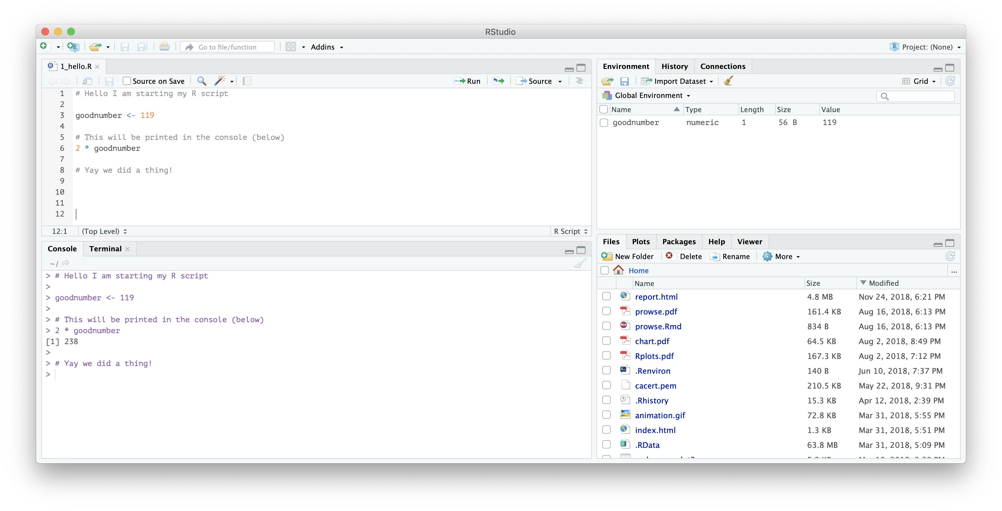
basics
What does our screen look like now?
Our script; our instructions
The object goodnumber is in our environment to use
Output

Slide 27
basics
Exercise
Define an object to be equal to 90
Print your number to the console
Multiply the object by 100
Divide the object by 10
my_number <- 90
print(my_number)
[1] 90
my_number * 100
[1] 9000
my_number / 10
[1] 9

Slide 28
basics
Functions
A function takes inputs (arguments) and produces outputs.
We can use the c function to combine numbers into a series of numbers (a vector):
c(3, 4, 5)
Combine the numbers 3, 4 and 5 into a single vector
[1] 3 4 5

Slide 29
basics
Functions
We can nest functions (put one inside another):
But nesting is hard to read (especially when there are lots of steps)
Alternatively:
mean(c(3, 4, 5))
Combine the numbers 3, 4 and 5 into a vector, then take the mean of that vector.
[1] 4
goodnumbers <- c(3, 4, 5)
mean(goodnumbers)
Combine the numbers 3, 4 and 5 into a vector and assign it to goodnumbers.
Take the mean of goodnumbers.
[1] 4

Slide 30
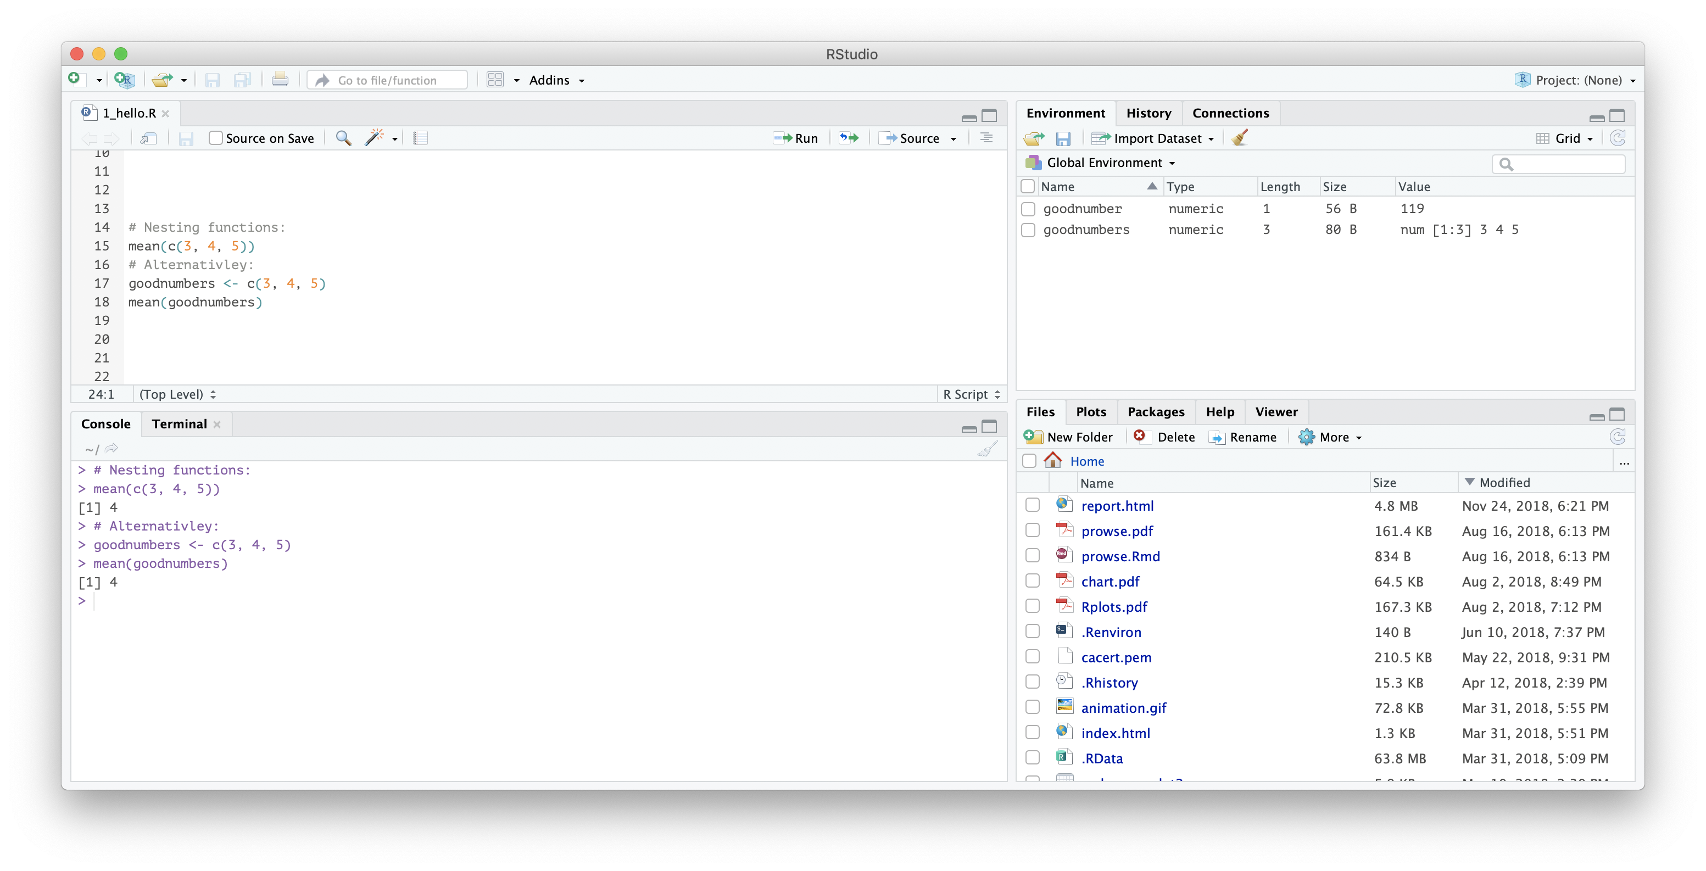
basics
We run our script and the console will show:
Functions
Our script; our instructions
The object goodnumber is in our environment to use
Output in our console

Slide 31
basics
Looking at some data
R comes with some small datasets pre-installed.
One is called mtcars. You can look at it by printing it:
print(mtcars)
mpg cyl disp hp drat wt qsec vs am gear carb
Mazda RX4 21.0 6 160.0 110 3.90 2.620 16.46 0 1 4 4
Mazda RX4 Wag 21.0 6 160.0 110 3.90 2.875 17.02 0 1 4 4
Datsun 710 22.8 4 108.0 93 3.85 2.320 18.61 1 1 4 1
Hornet 4 Drive 21.4 6 258.0 110 3.08 3.215 19.44 1 0 3 1
Hornet Sportabout 18.7 8 360.0 175 3.15 3.440 17.02 0 0 3 2

Slide 32
basics
Hot tip
To find out more information about a function or dataset, use ?
?mean
?mtcars

Slide 33
basics
Looking at some data
We can look at a single column using $:
And we can use this to generate summary statistics about the dataset:
print(mtcars$mpg)
mean(mtcars$mpg)
Extract the mpg column from the mtcars dataset, and then take the mean.
[1] 20.09062

Slide 34
basics
Exercise
Find the names of the variables in mtcars using the names() function.
names(mtcars)
[1] "mpg" "cyl" "disp" "hp" "drat" "wt"
[7] "qsec" "vs" "am" "gear" "carb"
Assign the wt variable to an object.
weight <- mtcars$wt
Find the median, mean and standard deviation (sd) of your object.
mean(weight)
median(weight)
sd(weight)
[1] 3.21725
[1] 3.325
[1] 0.9784
Plot a histogram of your object using hist().
hist(weight)

Slide 35
basics
Packages
R uses functions to do things. A package is a collection of functions.
Some packages are installed when you install R. this is called “base R”
Other user-written packages can be installed using:
install.packages(“nameofpackage”)

Slide 36

basics
Packages
The tidyverse is a package
(Well, the tidyverse is a collection of packages)
They are intuitive and consistent.
They help you read, transform and visualise your data with less hassle.
It’s best to see how these functions are used.

Slide 37
basics
Packages
The tidyverse is a package
You can install the tidyverse by writing this in your console:
install.packages(“tidyverse”)
When you do this, your console will explode with activity. This is okay!
You only have to install a package once.

Slide 38
basics
Packages
The tidyverse is a package
You have installed the tidyverse. Now you have to load it using library:
library(tidyverse)
You have to load the package each time you use R.

Slide 39
basics
We have R and R Studio up-and-running.
We have written a comment, defined an object and run a simple analysis.
Now we just have to learn how to do more:
a process you will continue as long as you’re using R.
And now we’re coders

Slide 40

basics
(and we have lots of help)
And now we’re coders
‘Me “working independently”’ by Allison Horst, @allison_horst

Slide 41
read

Slide 42
read
We need to get data into R
This means:
Starting an R Project.
Finding data.
Saving data onto your computer.
Reading the data into R.

Slide 43
read
We need to get data into R
1. Starting an R Project
To read things into and export out of R, it needs to know where it is.
A handy way to do this is by setting up an an R Project.
where am I?
See a full discussion of this at https://r4ds.had.co.nz/workflow-projects.html

Slide 44
read
We need to get data into R
1. Starting an R Project
Within R Studio, click File -> New Project
Select New Directory -> New Project
Call the file r_course (or whatever you’d like) and create the project in your Documents folder.
EXISTING DIRECTORY?

Slide 45

read
We need to get data into R
1. Starting an R Project
Now R knows where it is! ->
Take a look at your newly made folder on your computer.
Opening the r_course.Rproj file will open R Studio, telling R where it is.
Then, create a new script: File -> New File -> R Script.

Slide 46
read
We need to get data into R
2. Finding data
We are going to use a ‘clean’ version of the gapminder dataset.
It contains information about income and life expectancy of countries over time.
The gapminder dataset was created by https://www.gapminder.org/. The cleaned version was made by Jenny Bryan and can be found at https://github.com/jennybc/gapminder.

Slide 47
read
We need to get data into R
3. Saving data on your computer.
This usually involves going to a website and downloading a file (eg an Excel file or csv file).
Create a folder called data in your project folder.
We will store our file the file in a folder called data in your project folder.

Slide 48
read
We need to get data into R
3. Saving data on your computer.
You can download the dataset here:
https://tinyurl.com/essadata1
Save it in your r_course/data file by going to the address and clicking File -> Save Page As

Slide 49
read
We need to get data into R
4. Reading data into R
We have our data. It is saved in our data folder.
We need to read it into our R environment.

Slide 50
read
We need to get data into R
4. Reading data into R
We will use the read_csv function from the tidyverse.
First, we have to load the tidyverse:
Then, read our data file and assign it to an object:
library(tidyverse)
gapminder <- read_csv(“data/gapminder.txt”)

Slide 51
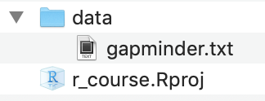
read
All together now: our folder should look like this

Slide 52
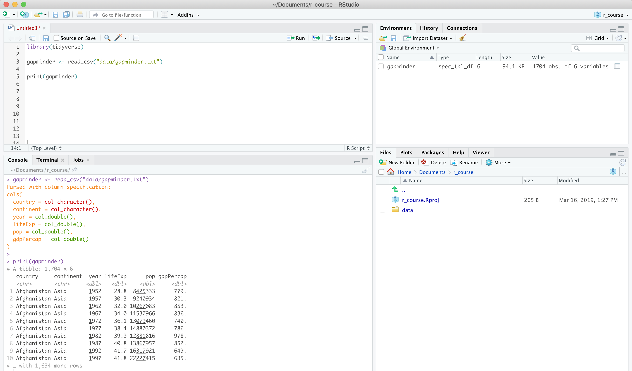
read
All together now: our R Studio should look like this

Slide 53
read
We have our data in R
We have the tidyverse loaded.
We have read the gapminder dataset.
The gapminder dataset is in our environment.
Wonderful. Let’s do more!

Slide 54
read
Exercise
Find the names of the variables in gapminder.
names(gapminder)
View the gapminder dataset using the View() function.
Note the capital V.
View(gapminder)
Look at the unique values in the year column $.
unique(gapminder$year)
Create a histogram of the gdpPercap variable.
hist(gapminder$gdpPercap)

Slide 55
visualise

Slide 56
visualise
Visualising our data
Scatterplots of the ‘Datasaurus Dozen
It is important (and fun) to visualise our data.
The Datasaurus Dozen:
Averages of the X and Y values are the same.
Standard deviation is the same.
Same correlation between the X and Y axes.
X
Y
From Matejka & Fitzmaurice (2019) Same Stats, Different Graphs. See the summary here: https://www.autodeskresearch.com/publications/samestats

Slide 57
visualise
Visualising our data
It is important (and fun) to visualise our data.
We do this with the ggplot package.
It requires:
Data: what data to use.
Aesthetics: mapping your data to aspects of the chart:
X axis, Y axis, colour, size, shape, etc.
Geom: how to put your aesthetics on the chart.

Slide 58
visualise
don’t copy this code down; just watch for now
Visualising our data
Data:
ggplot(data = gapminder) +
aes(x = lifeExp, y = gdpPercap,
colour = continent) +
geom_point()
Aesthetics:
Geom:

Slide 59
visualise
don’t copy this code down; just watch for now
Breaking it down
ggplot()
(an empty plot)

Slide 60
visualise
don’t copy this code down; just watch for now
Breaking it down
ggplot(data = gapminder)

Slide 61
visualise
don’t copy this code down; just watch for now
Breaking it down
ggplot(data = gapminder) +
aes(x = lifeExp)

Slide 62
visualise
don’t copy this code down; just watch for now
Breaking it down
ggplot(data = gapminder) +
aes(x = lifeExp,
y = gdpPercap)

Slide 63
visualise
don’t copy this code down; just watch for now
Breaking it down
ggplot(data = gapminder) +
aes(x = lifeExp,
y = gdpPercap) +
geom_point()

Slide 64
visualise
don’t copy this code down; just watch for now
Breaking it down
ggplot(data = gapminder) +
aes(x = lifeExp,
y = gdpPercap,
colour = continent) +
geom_point()

Slide 65
visualise
don’t copy this code down; just watch for now
Breaking it down
ggplot(data = gapminder) +
aes(x = lifeExp,
y = gdpPercap,
colour = continent,
size = pop) +
geom_point()

Slide 66
visualise
don’t copy this code down; just watch for now
Breaking it down
ggplot(data = gapminder) +
aes(x = lifeExp,
y = gdpPercap,
colour = continent,
size = pop) +
geom_point() +
geom_smooth()

Slide 67
visualise
don’t copy this code down; just watch for now
Breaking it down
ggplot(data = gapminder) +
aes(x = lifeExp,
y = gdpPercap,
colour = continent,
size = pop) +
geom_point() +
geom_smooth() +
scale_y_log10()

Slide 68
visualise
don’t copy this code down; just watch for now
Breaking it down
ggplot(data = gapminder) +
aes(x = lifeExp,
y = gdpPercap,
colour = continent,
size = pop) +
geom_point() +
geom_smooth() +
scale_y_log10() +
facet_wrap(~continent)

Slide 69
visualise
don’t copy this code down; just watch for now
Breaking it down
ggplot(data = gapminder) +
aes(x = lifeExp,
y = gdpPercap,
colour = continent,
size = pop) +
geom_point() +
geom_smooth() +
scale_y_log10() +
facet_wrap(~continent) +
theme_minimal()

Slide 70
visualise
don’t copy this code down; just watch for now
Breaking it down
ggplot(data = gapminder) +
aes(x = lifeExp,
y = gdpPercap,
colour = continent,
size = pop) +
geom_point(alpha = 0.3) +
geom_smooth() +
scale_y_log10() +
facet_wrap(~continent) +
theme_minimal()

Slide 71
visualise
don’t copy this code down; just watch for now
Breaking it down
ggplot(data = gapminder) +
aes(x = lifeExp,
y = gdpPercap,
colour = continent,
size = pop) +
geom_point(alpha = 0.3) +
geom_smooth() +
scale_y_log10() +
facet_wrap(~continent) +
theme_minimal() +
labs(title = “GDP per capita and life expectancy by continent”)

Slide 72
visualise
don’t copy this code down; just watch for now
Breaking it down
ggplot(data = gapminder) +
aes(x = lifeExp,
y = gdpPercap,
colour = continent,
size = pop) +
geom_point(alpha = 0.3) +
geom_smooth() +
scale_y_log10() +
facet_wrap(~continent) +
theme_minimal() +
labs(title = “GDP per capita and life expectancy by continent”,
x = “Life expectancy”)

Slide 73
visualise
don’t copy this code down; just watch for now
Breaking it down
ggplot(data = gapminder) +
aes(x = lifeExp,
y = gdpPercap,
colour = continent,
size = pop) +
geom_point(alpha = 0.3) +
geom_smooth() +
scale_y_log10() +
facet_wrap(~continent) +
theme_minimal() +
labs(title = “GDP per capita and life expectancy by continent”,
x = “Life expectancy”,
y = "GDP per capita”)

Slide 74
visualise
don’t copy this code down; just watch for now
Breaking it down
ggplot(data = gapminder) +
aes(x = lifeExp,
y = gdpPercap,
colour = continent,
size = pop) +
geom_point(alpha = 0.3) +
geom_smooth() +
scale_y_log10() +
facet_wrap(~continent) +
theme_minimal() +
labs(title = “GDP per capita and life expectancy by continent”,
x = “Life expectancy”,
y = "GDP per capita”,
colour = "Continent", size = "Population”,
caption = "Source: Gapminder https://www.gapminder.org/.")

Slide 75
visualise
Breaking it down
Recreate and save the final chart by copying the code:
ggplot(data = gapminder) +
aes(x = lifeExp,
y = gdpPercap,
colour = continent,
size = pop) +
geom_point(alpha = 0.3) +
geom_smooth() +
scale_y_log10() +
facet_wrap(~continent) +
theme_minimal() +
labs(title = “GDP per capita and life expectancy by continent”,
x = “Life expectancy”,
y = "GDP per capita”,
colour = "Continent", size = "Population”,
caption = "Source: Gapminder https://www.gapminder.org/.")
ggsave(“scatter_countries.png")

Slide 76
visualise
Exercise
Create a scatter plot using the gapminder dataset.
Show GDP per capita on the x axis and population on the y axis.
Colour should represent life expectancy.
Set the transparency to 0.8.
Using alpha = 0.8
Set the size to 3.
Using size = 3
Set the x axis to scale to log 10.
Set the y axis to scale to log 10.
Set the theme to theme_dark.
Broody.

Slide 77
visualise
Making it dance
We need to install a few additional packages:
install.packages(“gifski”)
install.packages(“png”)
install.packages(“gganimate”)
library(gganimate)
ggplot(data = gapminder) +
aes(x = lifeExp,
y = gdpPercap,
colour = continent) +
geom_point(size = 3) +
scale_y_log10() +
facet_wrap(~continent) +
labs(title = “Year {round(frame_time, 0)}”) +
transition_time(year)

Slide 78
transform

Slide 79
transform
Transforming our data
We want transform our data as we wish.
We do this using functions in the dplyr package.
They have intuitive names like
filter to filter
select to select variables, and
summarise (to summarise).
Notes:
Rephrase this

Slide 80
transform
A quick side-note about pipes
This is a pipe: %>%
The keyboard shortcut is CMD + SHIFT + M.
It means:
take the thing on the left and pipe it %>% into the first argument of the function on the right.
For example:
sum(10, 19)
is the same as
10 %>% sum(19)
[1] 19
[1] 19
Notes:
Rephrase this

Slide 81
transform
Our gapminder dataset:
country | continent | year | lifeExp | pop | gdpPercap
… | … | … | … | … | …
Australia | Oceania | 1952 | 69.1 | 8,691,212 | 10,040
Australia | Oceania | 1957 | 70.3 | 9,712,569 | 10,950
Australia | Oceania | 1962 | 70.9 | 10,794,968 | 12,217
Australia | Oceania | 1967 | 71.1 | 11,872,264 | 14,526
Australia | Oceania | 1972 | 71.9 | 13,177,000 | 16,789
Australia | Oceania | 1977 | 73.5 | 14,074,100 | 18,334
Australia | Oceania | 1982 | 74.7 | 15,184,200 | 19,477
Australia | Oceania | 1987 | 76.3 | 16,257,249 | 21,889
Australia | Oceania | 1992 | 77.6 | 17,481,977 | 23,425
Australia | Oceania | 1997 | 78.8 | 18,565,243 | 26,998
Australia | Oceania | 2002 | 80.4 | 19,546,792 | 30,688
Australia | Oceania | 2007 | 81.2 | 20,434,176 | 34,435
… | … | … | … | … | …

Slide 82
transform
Picture the gapminder dataset it in your mind.
In your mind:
Create a new column gdp that is the product of gdpPercap and pop.
Filter the observations to exclude those from 2007.
Remove the gdpPercap column.
What does this dataset look like now?

Slide 83
transform
Add a column with mutate()
country | continent | year | lifeExp | pop | gdpPercap
… | … | … | … | … | …
Australia | Oceania | 1952 | 69.1 | 8,691,212 | 10,040
Australia | Oceania | 1957 | 70.3 | 9,712,569 | 10,950
Australia | Oceania | 1962 | 70.9 | 10,794,968 | 12,217
Australia | Oceania | 1967 | 71.1 | 11,872,264 | 14,526
Australia | Oceania | 1972 | 71.9 | 13,177,000 | 16,789
Australia | Oceania | 1977 | 73.5 | 14,074,100 | 18,334
Australia | Oceania | 1982 | 74.7 | 15,184,200 | 19,477
Australia | Oceania | 1987 | 76.3 | 16,257,249 | 21,889
Australia | Oceania | 1992 | 77.6 | 17,481,977 | 23,425
Australia | Oceania | 1997 | 78.8 | 18,565,243 | 26,998
Australia | Oceania | 2002 | 80.4 | 19,546,792 | 30,688
Australia | Oceania | 2007 | 81.2 | 20,434,176 | 34,435
… | … | … | … | … | …
gdp
…
87,259,768,480
106,352,630,550
131,882,124,056
172,456,506,864
221,228,653,000
258,034,549,400
295,742,663,400
355,854,923,361
409,515,311,225
501,224,430,514
599,851,952,896
703,650,850,560
…

Slide 84
transform
Doing that in code:
Create a new column gdp that is the product of gdpPercap and pop.
Create or change columns using mutate.
Redefine the object gapminder
to be the gapminder dataset and
gapminder07 <- gapminder %>%
mutate(gdp = gdpPercap * pop)
mutated to have an additional column called gdp which is the product of gdpPercap and pop.
Notes:
Add pipe shortcut + info on pipe

Slide 85
transform
Filter with filter()
country | continent | year | lifeExp | pop | gdpPercap
… | … | … | … | … | …
Australia | Oceania | 1952 | 69.1 | 8,691,212 | 10,040
Australia | Oceania | 1957 | 70.3 | 9,712,569 | 10,950
Australia | Oceania | 1962 | 70.9 | 10,794,968 | 12,217
Australia | Oceania | 1967 | 71.1 | 11,872,264 | 14,526
Australia | Oceania | 1972 | 71.9 | 13,177,000 | 16,789
Australia | Oceania | 1977 | 73.5 | 14,074,100 | 18,334
Australia | Oceania | 1982 | 74.7 | 15,184,200 | 19,477
Australia | Oceania | 1987 | 76.3 | 16,257,249 | 21,889
Australia | Oceania | 1992 | 77.6 | 17,481,977 | 23,425
Australia | Oceania | 1997 | 78.8 | 18,565,243 | 26,998
Australia | Oceania | 2002 | 80.4 | 19,546,792 | 30,688
Australia | Oceania | 2007 | 81.2 | 20,434,176 | 34,435
… | … | … | … | … | …
gdp
…
87,259,768,480
106,352,630,550
131,882,124,056
172,456,506,864
221,228,653,000
258,034,549,400
295,742,663,400
355,854,923,361
409,515,311,225
501,224,430,514
599,851,952,896
703,650,850,560
…
Dropped
Kept

Slide 86
transform
Doing that in code:
Filter the observations to exclude those from 2007.
Filter observations using filter.
== means is equal to
!= means is not equal to
Redefine the object gapminder
to be the gapminder07 dataset and
gapminder07 <- gapminder07 %>%
filter(year == 2007)
filtered to keep all observations where year IS equal to 2007.

Slide 87
transform
Drop a variable with select()
country | continent | year | lifeExp | pop | gdpPercap
… | … | … | … | … | …
Australia | Oceania | 1952 | 69.1 | 8,691,212 | 10,040
Australia | Oceania | 1957 | 70.3 | 9,712,569 | 10,950
Australia | Oceania | 1962 | 70.9 | 10,794,968 | 12,217
Australia | Oceania | 1967 | 71.1 | 11,872,264 | 14,526
Australia | Oceania | 1972 | 71.9 | 13,177,000 | 16,789
Australia | Oceania | 1977 | 73.5 | 14,074,100 | 18,334
Australia | Oceania | 1982 | 74.7 | 15,184,200 | 19,477
Australia | Oceania | 1987 | 76.3 | 16,257,249 | 21,889
Australia | Oceania | 1992 | 77.6 | 17,481,977 | 23,425
Australia | Oceania | 1997 | 78.8 | 18,565,243 | 26,998
Australia | Oceania | 2002 | 80.4 | 19,546,792 | 30,688
Australia | Oceania | 2007 | 81.2 | 20,434,176 | 34,435
… | … | … | … | … | …
gdp
…
87,259,768,480
106,352,630,550
131,882,124,056
172,456,506,864
221,228,653,000
258,034,549,400
295,742,663,400
355,854,923,361
409,515,311,225
501,224,430,514
599,851,952,896
703,650,850,560
…
Dropped

Slide 88
transform
Doing that in code:
Remove the gdpPercap column.
Drop columns using select.
Redefine the object gapminder
to be the gapminder07 dataset and
gapminder07 <- gapminder07 %>%
select(-gdpPercap)
Negatively select (drop) the variable gdpPercap

Slide 89
transform
Combining it all:
gapminder07 <- gapminder %>%
mutate(gdp = gdpPercap * pop) %>%
filter(year == 2007) %>%
select(-gdpPercap)
Take the gapminder dataset and
Add a column called gdp which is the product of gdpPercap and pop and
Filter observations where year does not equal 2007 and
Negatively select (drop) the variable gdpPercap.
Now the gapminder dataset is what you pictured!

Slide 90
transform
Exercise
Create a new dataset called aus
It should include:
Only observations from Australia.
The filter will be: country == “Australia”
A new variable called gdpPClife which is GDP per capita divided by life expectancy.
Plot a scatter plot using aus. It should show:
gdpPClife on one axis,
pop on the other, and
colour it by year.
Then, add a line plot with geom_line()
aus <- gapminder %>%
filter(country == "Australia") %>%
mutate(gdpPClife = gdpPercap / lifeExp)
aus %>%
ggplot() +
aes(gdpPClife,
pop,
colour = year) +
geom_point() +
geom_line()
Notes:
Using again the gapminder dataset

Slide 91
visualise
Making a map
We use the same ggplot ideas to plot maps.
We just need a variable that contains the geometries of each area.
sf (simple features) objects are great at this:
they are normal datasets with a ‘special’ variable called geometry;
this geometry variable contains the instructions on how to draw the area.
‘Be a space wrangler’ by Allison Horst,
https://twitter.com/allison_horst/status/1071456081308614656

Slide 92
visualise
Making a map
There is a file in your data folder that contains this geometry variable, called gapmapdata.Rds
First, we install and load the sf package:
Then we read the data file using read_rds:
install.packages(“sf”)
library(sf)
gapmap <- read_rds(“data/gapmapdata.Rds”)

Slide 93
visualise
Making a map
Now we use the same ggplot syntax:
Data
Aesthetics
Geom
We’ll start by plotting an empty world map:
ggplot(data = gapmap) +
aes(geometry = geometry) +
geom_sf()

Slide 94
visualise
Making a map
And we can add an aesthetic: fill the countries by gdpPercap
ggplot(data = gapmap) +
aes(geometry = geometry,
fill = gdpPercap) +
geom_sf()

Slide 95
visualise
Making a map
With filtering, we can look at countries just in the Americas:
1.
2.
3.
4.
5.
gapmap %>%
filter(continent == “Americas”) %>%
ggplot() +
aes(geometry = geometry,
fill = gdpPercap) +
geom_sf()
In words:
1. Take the gapmap dataset
2. And filter to keep the Americas continent
3. Pipe %>% this into the data argument of ggplot()
4. Define aesthetics
5. Use geom_sf, which plots geometries.

Slide 96
extra

Slide 97
extra
Using R Markdown
R Markdown is a type of file that produces documents.
It will process your R code and its output, then typeset/produce your file.
It uses the same wonderful math language as LaTeX, too.
Using an R Markdown document means your analysis, your visualisations and your writing are all in one place.
To start an R Markdown document, click:
File ->
New File ->
R Markdown

Slide 98
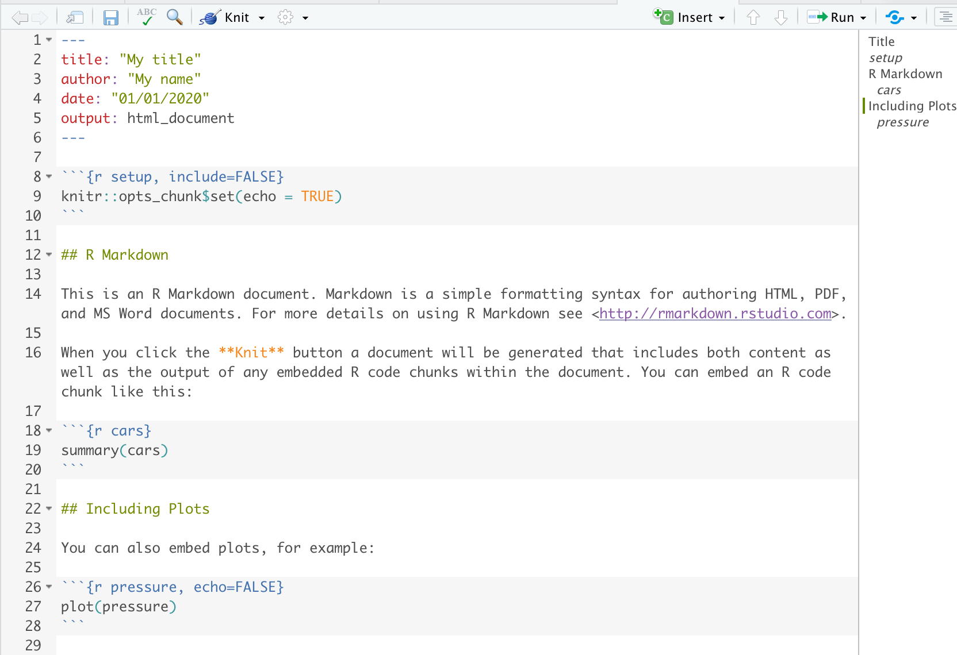
extra
Using R Markdown
This will set you up and explain a few things.
Click the Knit button to compile your document.
YAML: instructions for your R Markdown output
A level-2 header
Your text. Just write as your normally would.
A chunk of R code
Another chunk of R code

Slide 99
extra
Resources
This short workshop can’t cover everything. Below are some resources by topic that I have used in the past (and still use today!)
Note: they are all free.
Data visualisation with ggplot
Healy: Data Visualization: A practical introduction at https://socviz.co/
Wickham: R for Data Science, chapter 3 at https://r4ds.had.co.nz/data-visualisation.html
Yau: Flowing data at https://flowingdata.com
R Studio: ggplot cheatsheet at https://www.rstudio.com/wp-content/uploads/2015/03/ggplot2-cheatsheet.pdf
Transforming data with dplyr
Wickham: R for Data Science, chapter 5 at https://r4ds.had.co.nz/transform.html
R Studio: dplyr cheatsheet: https://www.rstudio.com/wp-content/uploads/2015/02/data-wrangling-cheatsheet.pdf

Slide 100
extra
Resources
Analysis:
Working with time series data
Wickham: R for Data Science, chapter 16 at https://r4ds.had.co.nz/dates-and-times.html
Earo Wang (a Monash graduate and PHD candidate): Melting the Clock: tidy time-series analysis presentation at R Studio conference at https://slides.earo.me/rstudioconf19
The above presentation includes information about the tsibble and fable time-series packages, which were created by Di Cook and Earo Wang from Monash.
Communication:
R Markdown
R Studio: R Markdown Quick Tour at https://rmarkdown.rstudio.com/authoring_quick_tour.html
Wickham: R for Data Science, chapter 27 at https://r4ds.had.co.nz/r-markdown.html
’Shiny’ web applications
R Studio: Shiny tutorials at https://shiny.rstudio.com/tutorial/
and gallery at: https://shiny.rstudio.com/gallery/

Slide 101
extra
Resources
For everything else:
Google: asking well-phrased questions on Google will give you plenty of good answers.
If you’re asking about ggplot, state ggplot in your question:
‘How to change the default colours ggplot’
If you’re asking about dplyr, state dplyr in your question:
‘How to group observations together dplyr’
If you’re not sure what package, specify that you’re using R:
‘How to save a dataset in R’
It sounds silly, but being good at googling things will get you a long, long way.

Slide 102
thanks!
Thanks for coming

